Slide 1

Network Communications (NetCom) Move/Leave Training Webinar
January 4, 2012
Notes:
The ITS Move and Leave practice interact with corporate Human Resources’ (HR) move and staffing policies.
The practices are to be followed by all American Water (AW) ITS employees and/or contractors who are responsible for hiring, moving, and providing orientation to employees, contractors, and consultants.
Note: This practice does not cover American Water’s non-regulated companies.
For more information on the Move and Leave practices, see the links to these documents at the end of this webinar.

Slide 2
 | Instructor Guide
 | Slide 2 of 31 | File Name: NetCom Move Training Webinar
 |  | Short Description: NetCom’s role and responsibilities in the Move/Leave processes as well as a brief recap of the Join or On Boarding process.
Team Responsible: ITS
Document Reviewers: The following have performed quality review of this document:
Name | Title | Date | Version
Rob Crump
Leslie Wood | Technical Writer
Document Version History:
Date | Version | Description | Author
01/04/2012 | 1.0 |  | Leslie Wood
Document Approvers: The following have reviewed and approved this document:
Name | Title | Date | Version
Related Documents

Slide 3

Network Communications (NetCom) Move/Leave Training Webinar Introduction
Welcome to the NetCom Move/Leave Training Webinar.
Description:
The focus of this training webinar is to instruct learners on NetCom’s roles and responsibilities in the Information Technology Systems (ITS) department’s Move & Leave processes at American Water.
Audience:
Network Communications
Notes:
Welcome to the NetCom Move/Leave Training Webinar.
Here, you’ll learn about NetCom’s roles and responsibilities in the ITS Move & Leave processes.

Slide 4

Training Webinar Navigation Tips
Here are a few tips on how to get the most out of this webinar:
  Follow along with the slides – The slides guide you through the training webinar and can be used as a future reference guide
  Key Process Changes – Some transactions in the Move and Leave processes are the same, but we have made changes. The webinar will highlight those changes and outline your role and responsibilities.
  Additional Training Resources – You can supplement your learning by taking advantage of other related materials available at the end of the training webinar.
  To download the presentation: [INSERT LINK]
Notes:
The slides in the presentation will guide you through the webinar. However, you might want to download a copy of the presentation to use as a future reference guide.

Slide 5
What You’ll Learn
At the end of this webinar, you’ll be able to:
  Explain NetCom’s roles and responsibilities in the ITS Move & Leave processes
  Identify other key players (and their roles) involved with NetCom in the Move & Leave processes
  Explain the steps involved in the Move & Leave processes and how they affect NetCom
  Define the targets and NetCom’s role in reaching those targets
Notes:
The purpose of the training is to familiarize NetCom with its roles and responsibilities during the ITS Move and Leave processes.
You’ll also learn the roles and responsibilities of the other key players in this process and how their involvement affects NetCom.
And, you’ll learn what the targets are and what you need to do to help reach those targets.
ITS has crafted a well-defined Joint Accountability Agreement (JAA) for both the Move and Leave Processes. These agreements are designed to correctly set expectations for both sides of the relationship and provide targets for accurately measuring performance to those objectives.

Slide 6

The AW Join Process (AKA On Boarding)
The Information Technology Systems (ITS) department’s Join process is a core service to American Water’s (AW) business and a critical support to Human Resources (HR). The Join process is similar to On-Boarding, as it has the:
  Same Operational Level Agreements (OLA)
  Same 14 day turn around target
    What’s different?
    SD Online has been updated and our clients now have access to a Join/Move/Leave services option
    Work orders are different
6
Notes:
The Information Technology Systems (ITS) department’s Join (or On- Boarding) process is a core service to American Water’s (AW) business and a critical support to Human Resources (HR).
Here at American Water, Join services are quite similar to our On Boarding services as the Join services have the same OLAs and the 14-day turn-around target. So, what’s different?
SD Online has been updated and ITS clients now have a Join/Move/Leave option.
We’ve created additional work orders to make the process more efficient.

Slide 7

Defining the Move & Leave Processes
The ITS department’s Move & Leave processes are core services to AW businesses and a critical support to Human Resources (HR).
A ‘technical’ Move is the process of servicing an AW employee, consultant, and/or contractor’s technology needs. A ‘technical’ Leave involves collecting equipment and removing access.
  The two main components of the Move process are access management and procurement management. These two practices make up a spectrum of cross-functional, interdependent activities that require well-expedited hand-offs between events for successful completion.
  The two main components of the Leave process are timely access removal and the return of AW equipment. These two practices also make up a spectrum of cross-functional, interdependent activities that require well-expedited hand-offs between events for successful completion.
7
Notes:
The Information Technology Systems (ITS) department’s Move & Leave processes are core services to American Water’s (AW) businesses and a critical support to Human Resources (HR).
The practices in both the Move and Leave processes make up a spectrum of cross-functional, interdependent activities that require well-expedited hand-offs between events for successful completion

Slide 8

The Goal
The goal of refining the Move & Leave processes is to ensure that the ITS department effectively and efficiently provides these services to all AW employees, contractors, and consultants in an efficient and effective manner.
Why is it Important?
The streamlined transition between interdependent events and the timely cooperation between departments are essential for the Move & Leave processes to run efficiently.
ITS’ goal is to provide streamlined procedures for handling both the Move and Leave processes.
Notes:
ITS’ goal is to provide streamlined procedures for handling both the Move and Leave processes.
ITS is committed to ensuring that each side of the relationship has the necessary knowledge to optimize their actions and meet the performance objectives defined by the metrics.

Slide 9
The Desk Phone (in stock)
In the Join and Move processes, NetCom’s main involvement concerns the system setup of the desk phone. In the Leave process, NetCom’s main involvement is de-provisioning the desk phone.
The next few slides review the process flow and outline NetCom’s roles and responsibilities during the setup of an ‘in-stock’ desk phone.
9
Notes:
In the Move & Leave processes, NetCom’s main involvement is the system setup of the desk phone.
The next few slides review the process flow and outline NetCom’s roles and responsibilities during the setup of an ‘in-stock’ desk phone

Slide 10

Desk Phone (in Inventory) Flow
10
Notes:
This flow chart is designed to show you how the steps in this process fit together, illustrate how the process works, and (hopefully) clarify your understanding of the process.
Note: For those of you who would rather see a written out, step-by-step process, that information is also provided in this webinar.

Slide 11
Desk Phone in Inventory: Step-by-Step
Step 1
A Join/Move/Leave service request is submitted through SD Online
Service Desk (SD) receives request, and performs the initial analysis.
Field Services (FS) receives the work order, and checks inventory.
A Field Services Technician (FST)
creates an asset tag, records the MAC and DID numbers, and creates a work order for NetCom.
Depending on the circumstances either a Human Resources representative or a Functional Manager submits a Join/Move/Leave service request form in Service Desk (SD) Online.
This is where you’ll find the option for a desk phone.
Notes:
When a desk phone is needed, either a Human Resources representative or a Functional Manager submits a Join/Move/Leave service request form in Service Desk (SD) Online

Slide 12

Desk Phone in Inventory
Step 2
A Join/Move/Leave service request is submitted through SD Online
Service Desk receives request and performs the initial analysis.
Field Services (FS) receives the work order & and checks inventory.
.
A Field Services Technician (FST)
creates an asset tag, records the MAC and DID numbers, and creates a work order for NetCom.
The Service Desk (SD) receives the request, performs an initial analysis, creates a service ticket, (which auto-generates a work order for Field Services (FS), auto- determines the approval chain, and auto generates email notifications to the appropriate approvers.
Field Services receives the FIRST work order for the process.
Notes:
In the second step, The Service Desk:
receives the request
performs an initial analysis of the request
creates a service ticket, (which auto-generates a work order for Field Services (FS),
auto- determines the approval chain
auto generates email notifications to the appropriate approvers.
This is the FIRST of several work orders in this process.

Slide 13
Desk Phone in Inventory
Step 3
A Join/Move/Leave service request is submitted through SD Online
Service Desk (SD) receives request, and performs the initial analysis.
Field Services (FS) receives the work order, and checks inventory.
A Field Services Technician (FST) creates an asset tag, records the MAC and DID numbers, and creates a work order for NetCom.
Field Services (FS) receives the work order, performs an initial analysis including checking the inventory management system to determine if a desk phone is in stock.
In this example, the desk phone is in inventory.
Notes:
In the THIRD step, Field Services:
receives the work order
analyzes and prioritizes the work order
checks the inventory management system to determine if a desk phone is in stock.
In this example, the desk phone IS IN stock.

Slide 14
Desk Phone in Inventory
Step 4
A Join/Move/Leave service request is submitted through SD Online
Service Desk (SD) receives request, and performs the initial analysis.
Field Services (FS) receives the work order, and checks inventory.
A Field Services Technician (FST)
creates an asset tag, records the MAC and DID numbers, and creates a work order for NetCom.
A Field Services Technician (FST) retrieves the desk phone from inventory, creates an asset tag, records the phone’s MAC and DID numbers, and creates a phone system set up work order for NetCom, which MUST include all of the information (MAC, DID, etc.) recorded by the FST.
This is the SECOND work order in the process.
Notes:
Step 4 involves the SECOND work order in the process.
A Field Services Tech:
retrieves the desk phone from inventory
creates an asset tag for the desk phone
records the desk phone’s MAC and DID numbers
creates a phone system set up work order for NetCom, which MUST include all of the information (MAC, DID, etc.) recorded by the technician.

Slide 15
Desk Phone in Inventory
Step 5
Netcom receives work order, sets up desk phone in system, and creates a work order for FS
FS deploys the desk phone and trains the user
The FST completes the tasks of the work order, and closes the work order.
Service Desk performs the final analysis of the service request
NetCom receives the work order, records the information provided by the FST, sets up the desk phone in the Cisco Communications Management system, closes the work order, AND creates a desk phone deployment work order for Field Services.
This is the THIRD work order in the process.
15
Notes:
In Step 5 of the process, the THIRD work order is introduced and completed and NetCom creates the FOURTH work order for Field Services
1. NetCom receives the work order
2. NetCom records the information provided by the FST
3. NetCom sets up the desk phone in the Cisco Communications Management system
4. NetCom closes the work order
5. NetCom creates a desk phone deployment work order for Field Services.
At this point, NetCom receives the work order, records the information provided by the FST, sets up the desk phone in the Cisco Communications Management system, closes the work order, AND creates a desk phone deployment work order for Field Services. This is the 3rd work order in the process.

Slide 16
Desk Phone in Inventory
Step 6
Netcom receives work order, sets up desk phone in system, and creates a work order for FS
.
FS deploys the desk phone and trains the user
The FST closes the work order
Service Desk performs the final analysis of the service request
Field Services receives the desk phone deployment work order from NetCom, assigns a FST to the work order, deploys the desk phone, and trains the user.
16
Notes:
Here, Field Services receives the desk phone deployment work order from NetCom and immediately assigns a FST to the work order.
The FST deploys the desk phone, and trains the user.

Slide 17
Desk Phone in Inventory
Step 7
Netcom receives work order, sets up desk phone in system, and creates a work order for FS
.
FS deploys the desk phone and trains the user
The FST closes the work order
Service Desk performs the final analysis of the service request
The FST closes the work order.
17
Notes:
In Step 7, the Field Services technician closes the work order.
Note: It is important that the Field Services tech checks to ensure that all of the work associated with the various work orders has been completed as other wise the work order (s) will be bounced back to Field Services, which may or may not affect the target times.

Slide 18
Desk Phone in Inventory
Step 8
Netcom receives work order, sets up desk phone in system, and creates a work order for FS
.
FS deploys the desk phone and trains the user
The FST closes the work order
SD performs the final analysis of the service request
The Service Desk performs the final analysis of the service request and compares the initial client request to all of the closed work orders. If the work orders match up with the initial client request, SD updates the service call, completes the QA process, and closes the service ticket.
If the closed work orders DO NOT match the initial client request, the work orders are returned to Field Services requesting information on the outstanding issues and the service ticket remains open.
18
Notes:
This is a critical step in the process as this is where it’ll be determined weather or not the target was met.
In Step 8, the Service Desk:
performs the final analysis of the service request
compares the initial client request to the closed work orders.
If the work orders match up with the initial client request, SD updates the service call, completes the QA process, and closes the service ticket.
If the closed work orders DO NOT match the initial client request, the work orders are returned to Field Services requesting information on the outstanding issues and the service ticket remains open.

Slide 19

The Target – 2 Days
The target for an ‘in inventory’ desk phone setup and deployment is 2 days.
The clock starts ticking when Field Services receives the first work order and stops ticking when the Service Desk closes the original service ticket request.
2
In order to meet this target, the streamlined transition between interdependent events and the timely cooperation between departments is essential.
19
Notes:
Understanding the Joint Accountability Agreement is important as it clearly defines the services to be provided, the roles and responsibilities for how each service will be supported, quantifiable goals, criteria to assess performance, problem resolution procedures, and any incentives or penalties.
To view a copy of the Joint Accountability Agreement, see the link at the end of this webinar.

Slide 20
The Desk Phone (not in stock)
The next few slides review the process flow and outline NetCom’s roles and responsibilities during the deployment and setup for a desk phone that is not in inventory.
20
Notes:
The next few slides review the process flow of the steps associated with procuring, setting up, and deploying a desk phone and outline NetCom’s roles and responsibilities when a desk phone that is not in inventory.

Slide 21
Flow Chart for a Desk Phone (Not in Inventory)
21
Notes:
This flow chart is designed to show you how the steps in this process fit together, illustrate how the process works, and (hopefully) clarify your understanding of the process.

Slide 22
Desk Phone not in Inventory: Step-By-Step
A Functional Manager, AW employee, contractor or consultant submits a Join/Move/Leave request form in SD Online.
The Service Desk (SD) creates a service ticket, creates a desk phone work order for Field Services (FS), determines the appropriate approval chain, and auto-generates notifications to the appropriate approvers.
FS checks the inventory management system, determines that a phone must be purchased, and creates a procurement work order for Capital Management (CM).
CM receives the procurement work order, creates a P.O., and orders the desk phone from an external supplier.
Supplier receives order from CM and sends shipment information to CM.
Supplier ships desk phone to Field Services Technician (FST) in the employee's area.
22
Notes:
If Field Services determines that a desk phone is not in stock, the desk phone needs to be procured by Capital Management.

Slide 23
Desk Phone not in Inventory (con’t)
A FST takes receipt of the phone, records the MAC and DID numbers, creates an asset tag, and creates a set up phone in system work order for NetCom.
At the same time, using an 'As Built' form, FS sends notification to CM.
CM enters the ‘As Built’ form into the financial system and closes work order.
NetCom receives the set up phone work order, records the information provided by FS, sets up the phone in the system, and creates a deploy work order for FS.
FS receives work order, deploys phone, provides end user training, closes work order.
Service Desk performs final analysis and compares ALL completed work orders to the initial client service request. If work is complete, the SD updates the service ticket, completes the service call QA process, and closes the service ticket. If work was not completed, the work order is returned to Field Services requesting information on the outstanding issues, and the service ticket remains open.
23
Notes:
Once the FST takes receipt of the phone, records the MAC and DID numbers, creates an asset tag, the tech creates a set up phone in system work order for NetCom.

Slide 24
The Target – 15 Days
The target for a not in inventory desk phone procurement and deployment is 15 days.
For procurement, the clock starts ticking when FS creates the procurement work order for CM.
For deployment, the clock starts ticking when NetCom creates the deploy work order for FS.
The clock stops when the service ticket is closed.
15
In order to meet the target, the streamlined transition between interdependent events and the timely cooperation between departments is essential.
24
Notes:
Understanding the Joint Accountability Agreement is important as it clearly defines the services to be provided, the roles and responsibilities for how each service will be supported, quantifiable goals, criteria to assess performance, problem resolution procedures, and any incentives or penalties.
To view a copy of the Joint Accountability Agreement, see the link at the end of this webinar.

Slide 25
The Leave Process
The next few slides review the Leave process flow and outline NetCom’s roles and responsibilities.
25
Notes:
The objective of the Leave process is to ensure that the Information Technology Systems (ITS) department effectively and efficiently provides IT Leave services for employees, contractors, and consultants.
To ensure optimum service, all ITS processes that intersect with the various types of Leaves must adhere to the policies and practices in regard to their interaction with related activities. As outlined in the Leave Practice document.
For a copy of this document, please see the last slide of this presentation.

Slide 26
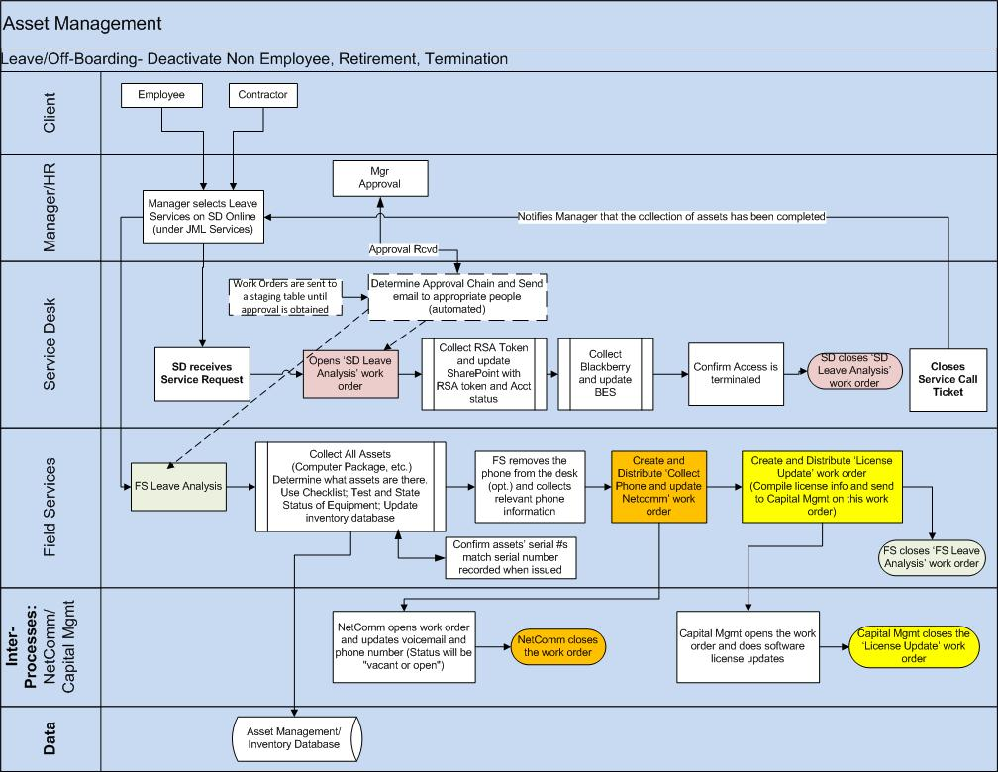
The Leave Process Flow
26
Notes:
This flow chart is designed to show you how the steps in this process fit together, illustrate how the process works, and (hopefully) clarify your understanding of the process.

Slide 27
The Desk Phone Leave Process: Step-By-Step
1. Functional Manager selects Leave services (under JML) on SD Online
2. Service Desk (SD) receives Leave request, determines approval chain, and sends email notifications to appropriate approvers
3. SD receives approvals, creates work order for Field Services to compare desk phone information (serial, MAC & DID numbers, extension, user name) to the original Join or Move request.
4. Field Services completes tasks associated with work order.
27
Notes:
Managers can access the Leave service by selecting the Join/Move/Leave option in SD Online.

Slide 28
The Desk Phone Leave Process: Step-By-Step
FS creates a work order for NetCom to remove user’s access to voicemail, and update the desk phone in the system.
NetCom receives work order, removes access, updates the phone in the system, changes the status of the desk phone to ‘Vacant’ or ‘Open’, and closes the work order.
Service Desk does final analysis of the work orders, compares initial client request to work orders. If all work has been completed, the service ticket is closed. If it has not been completed, the work order (s) are sent back to Field Services requesting information and the service ticket remains open.
28
Notes:
The ITS Leave process is a core service to AW businesses and a critical support to HR. A technical Leave is the process of servicing an employee, consultant, and contractor’s technology needs. The two main components of a Leave are access-de-provisioning management and equipment recovery management.

Slide 29
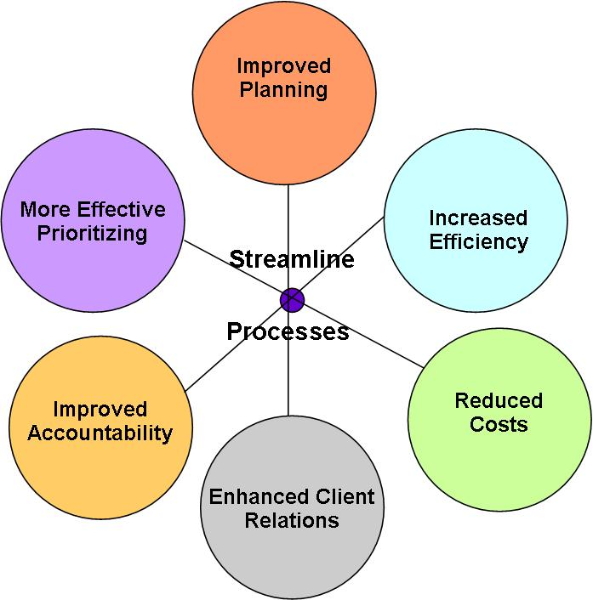
Benefits of the ‘New’ Move and Leave Processes
ITS has created two Joint Accountability Agreement (JAA) for the ‘new’ Leave and Move processes.
The two JAAs outline how service providers will deliver the promised services and what happens if the provider fails to meet the agreed-upon targets for those services.
29
Notes:
ITS’ services and service levels have evolved over the years due to input from our clients and the need to ensure alignment with AW’s business objectives. The new Joint Accountability Agreements (JAA) aim to manage the expectation of ITS services to its clients by setting target levels of service delivery.
In addition, by creating the JAA -- ITS has gained valuable performance information that will help us deliver improved levels of service.
The JAA process is in fact a quality process, using customer input to set target delivery levels, then measuring against these targets to identify if new resources or systems are needed.

Slide 30

NetCom Move/Leave Training Presentation
You’ll now be able to:
  Describe the steps involved in submitting a service request for procuring, setting up, and deploying a desk phone not in inventory
  Describe the steps involved in submitting a service request for setting up, and deploying a desk phone that is in inventory
  Explain the key players in the desk phone, procurement, set up, and deployment process
  Define the process targets
  Define your role in reaching those targets
Notes:
Thank you for your participation in this training webinar. If you haven’t downloaded the presentation, do so now as you can use it as a reference guide.
Does anyone have any questions? Concerns? Suggestions?

Slide 31

Resources
Post Training Support
Checklist
Quick Reference Guide
JAA Contracts
Practice Documents
Read the FAQs
Contact
Call
  Link here to the Training Portal for more
Notes:
For additional information about the ITS Move and Leave processes, see the above referenced documents.

